Slide 1

EYouth Website Testing
DEPI Project
By: 16/5/2025

Slide 2
Project Idea
Problem Statement
Ensuring a seamless, secure, and high-quality experience across all core features of the EYouth e-learning platform.
Proposed Solution:
Develop a robust, automated testing framework focused on verifying key functionalities:
User registration & login
Course browsing & enrollment
Payment processing
Content access & reviews
16/5/2025

Slide 3
Project Idea
Unique Value Proposition:
Validate core user functionalities.
Detect and report bugs prior to launch.
Ensure platform stability and performance.
Automate repetitive testing for efficiency.
16/5/2025

Slide 4
Project Wireframe
16/5/2025

Slide 5
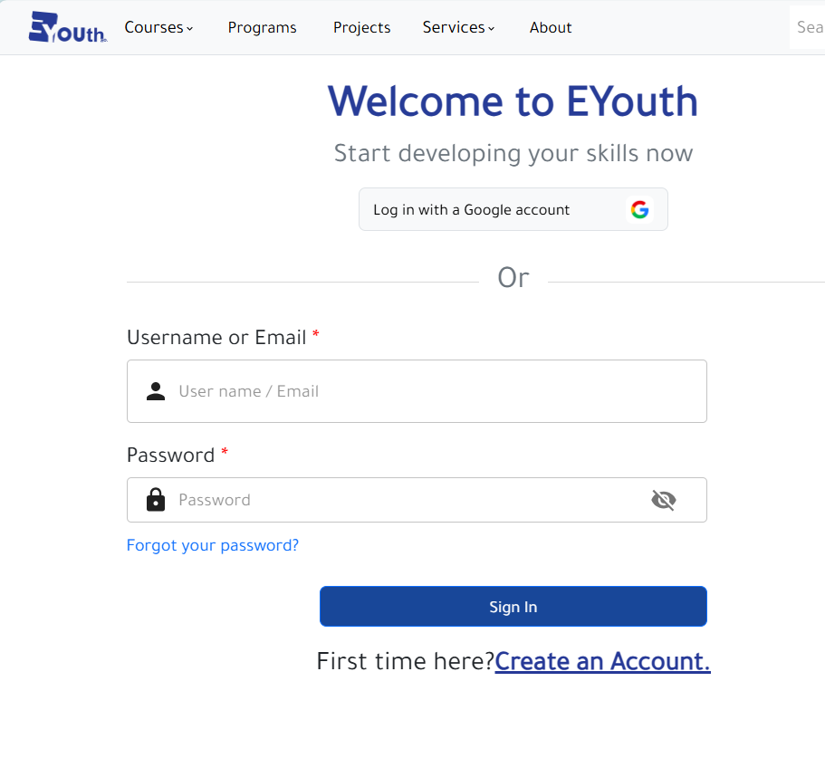
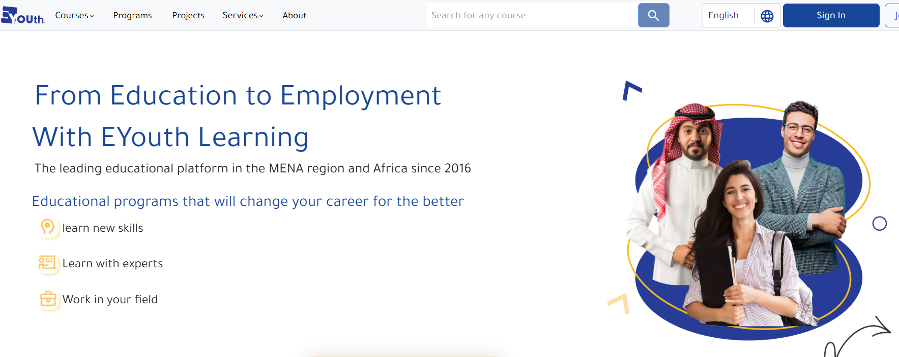
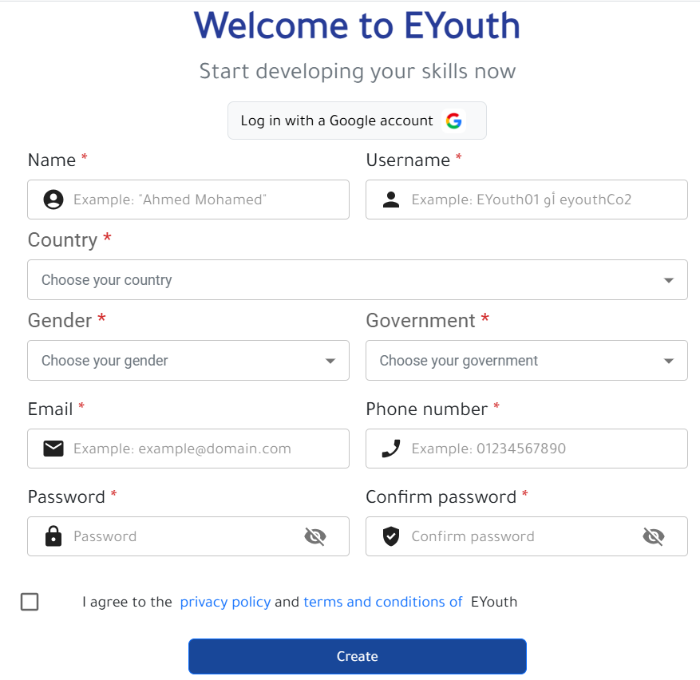
Login
Create account

Slide 6
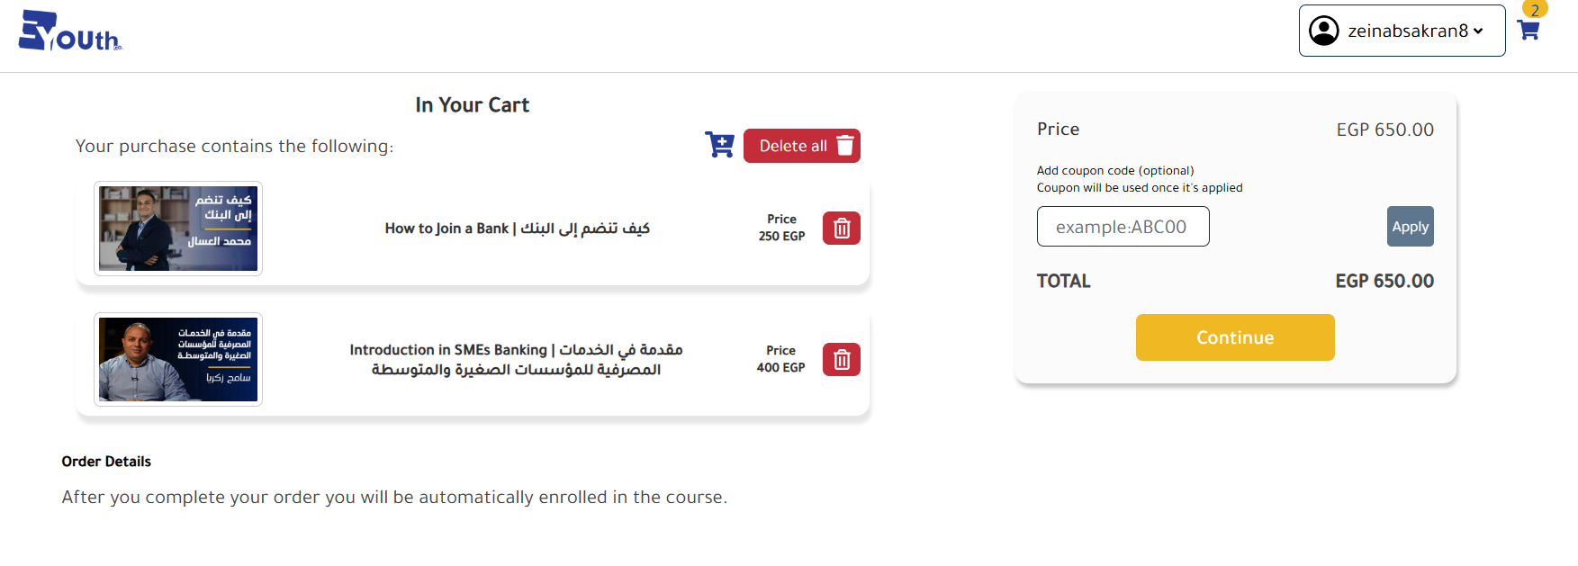
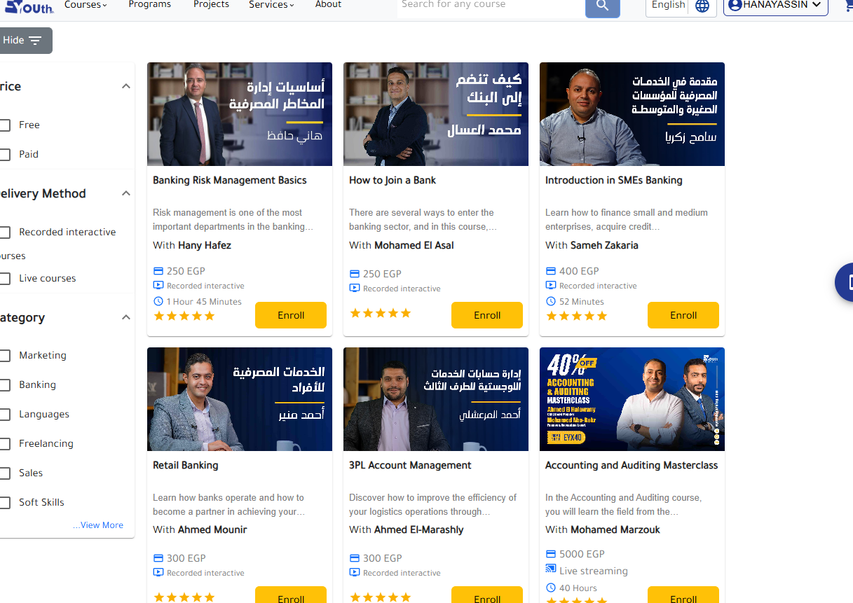
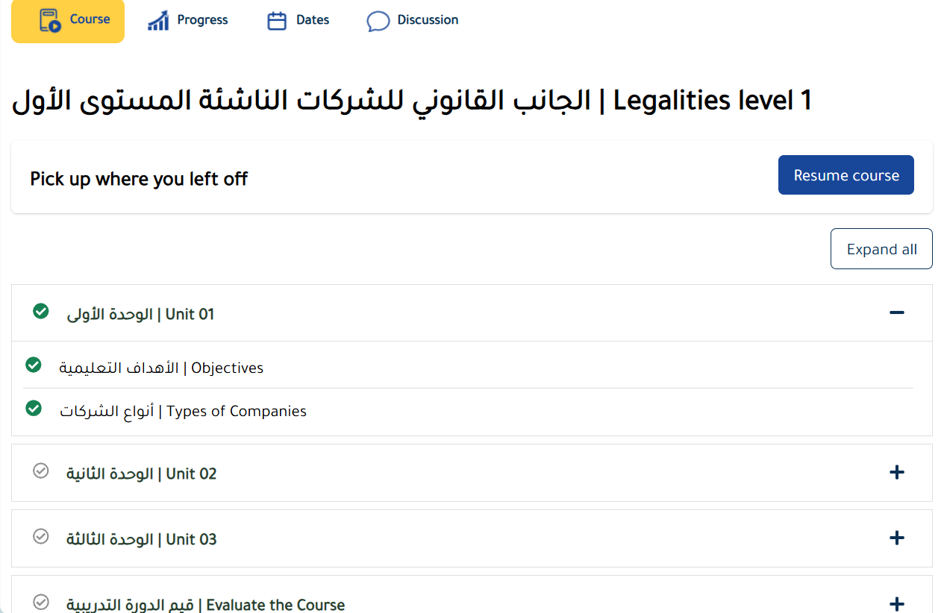
Paid
Free

Slide 7
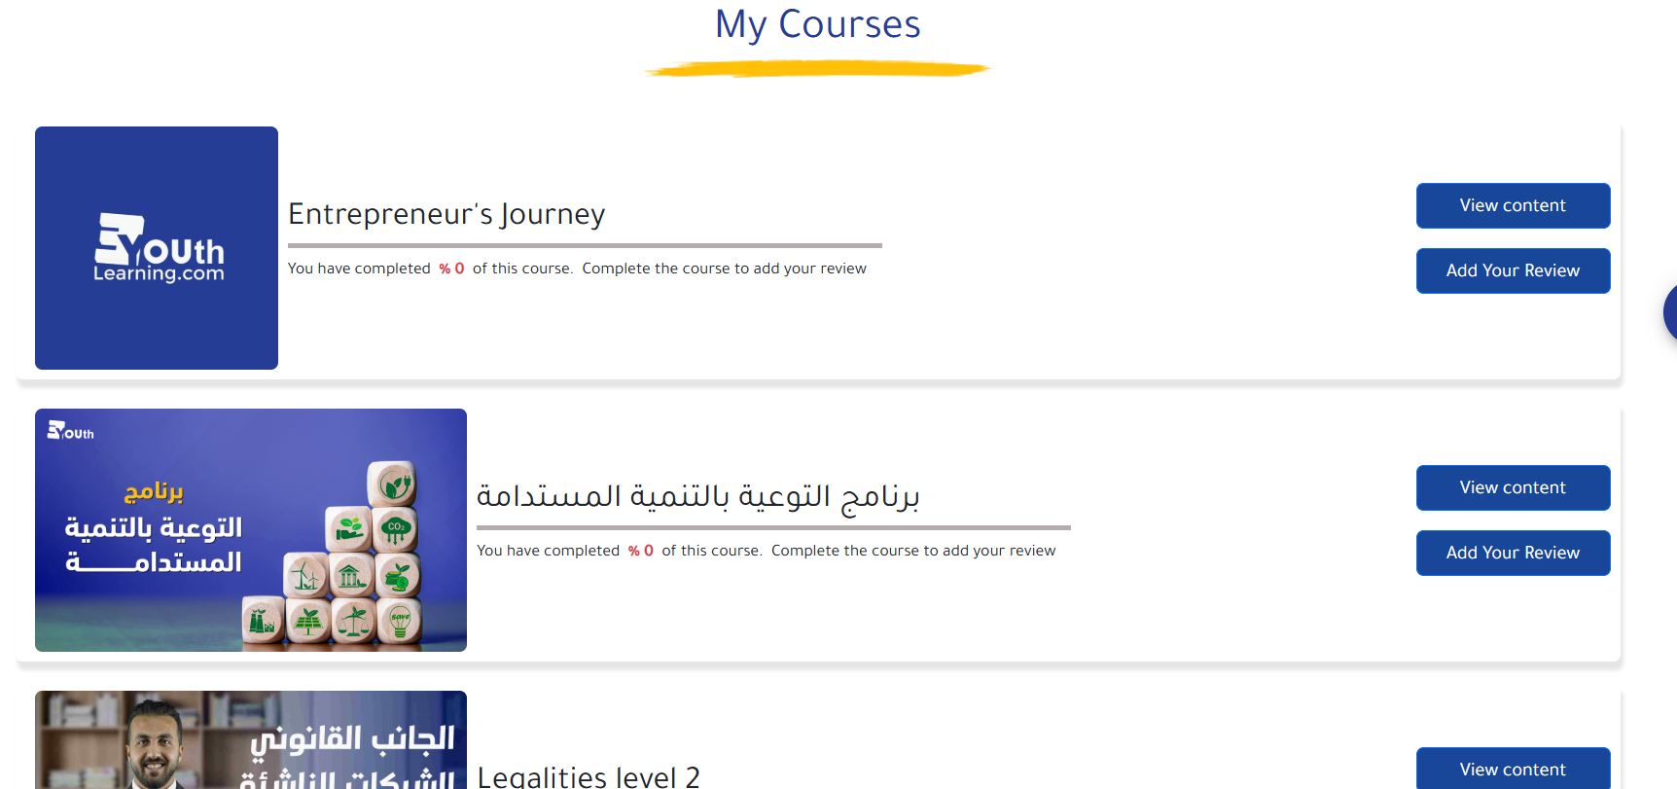
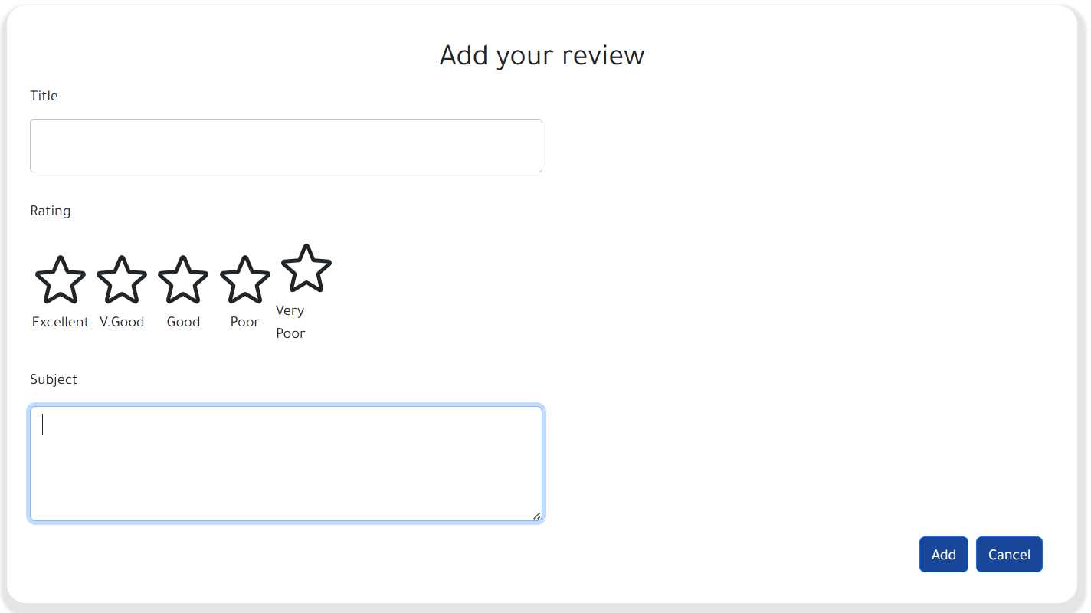
User Dashboard

Slide 8
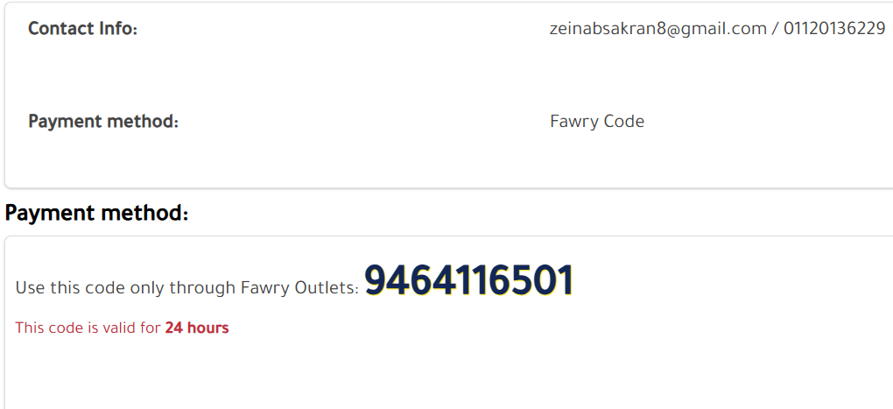
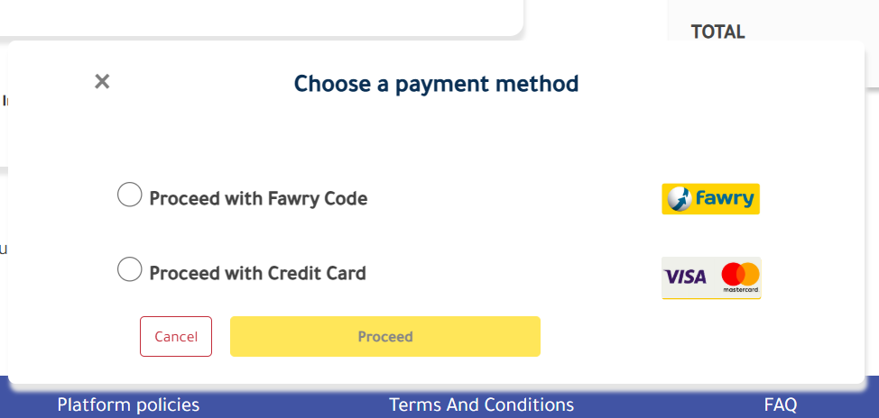
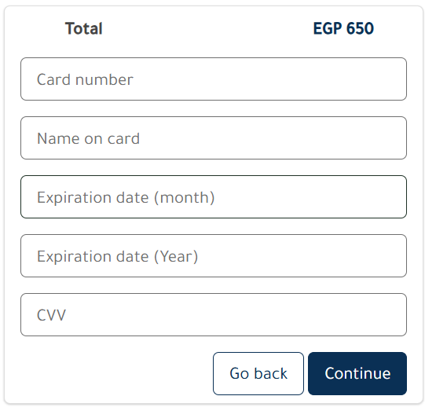
Fawry
Card

Slide 9
Features
Payment processing
Course Content Access
Course Reviews & Ratings
Notifications
App Download Button
Browsers and Devices
Registration
Login
Reset Password
Course Browsing
Course Enrollment
Add To Cart
16/5/2025

Slide 10
Java
Programming Languages & Frameworks
Testng management tool
POM Design Pattern

Slide 11
Tools & Technologies
Selenium
Chrome Developer tools
Google Sheets
Notes:
Implementation: Google Sheets
Automation Testing: Selenium WebDriver (Java)
Bug Tracking & Reporting: TestNG
Front-end Inspection: Chrome Developer Tools

Slide 12
Methodology
Manual Testing: Simulated real user behavior for features like login, registration, course browsing, etc.
Automation Testing: Developed scripts using Selenium WebDriver and TestNG for repetitive and critical test cases.
Bug Tracking & Documentation: Logged bugs and test results in Google Sheets and TestLink.
16/5/2025

Slide 13
Deliverables
Milestones
choose the website and get approval
Requirements Review Points → 24 Jan - 7 Feb
Test cases Design → 7 Feb - 7 Mar
Execution “Manual & Automation” → 8 Mar - 8 May
Bug Reporting
Reports & Documentations
Project Description
Technical requirements
Requirements Review
Test cases Design
Bug Report
16/5/2025

Slide 14
Project Team and Roles
Team Members
Key responsibilities
Enas AbdElkader Metwally
Hana Yassin Tawfik
Nour Ahmed
Samar farag Abdallah
Zeinab Sakran Mahmoud
Fatma AboElfotoh Abdel fattah
Responsible for Requirement 1 & 10 Responsible for Requirement 2 & 12
Responsible for Requirement 3 & 11
Responsible for Requirement 4 & 9
Responsible for Requirement 5 & 6
Responsible for Requirement 7 & 8

Slide 15
BiWeekly Google Meet
Collaboration methods &
Project Management
Documents sharing
Google Drive

Slide 16
Thank You
We welcome your questions, feedback, and collaboration ideas!

